Slide 1
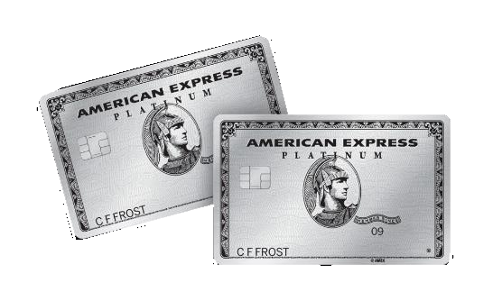
American Express-Default Prediction
Predict if a customer will default in the future

Slide 2
>>
Table of contents
1
Competition Description
2
Exploratory Data Analysis
3
Generate Machine Learning Model
4
Insight about ML models & TODO

Slide 3
1
Competition Description

Slide 4
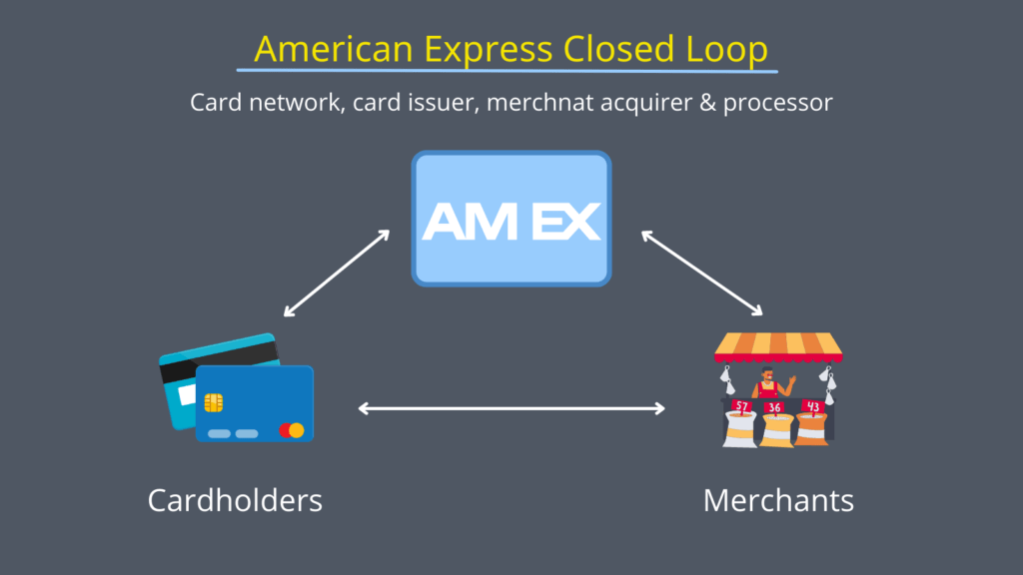
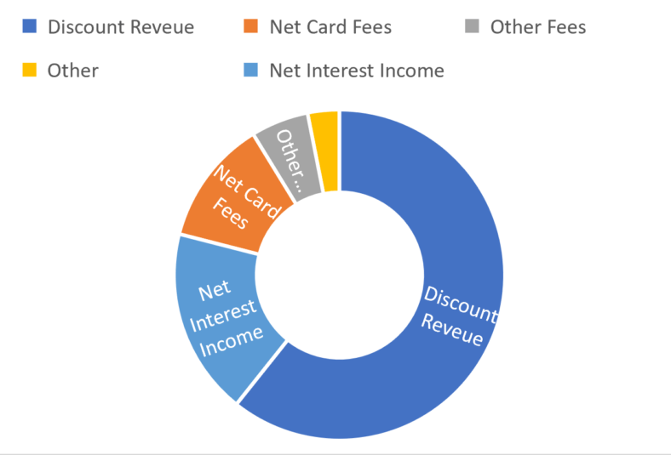
Part 1 >>
Competition Description
American Express Business Model
revenues

Slide 5
Discount Revenue(60%)
: 카드 결제 수수료
Part 1 >>
American Express Business Model
revenues

Slide 6
Discount Revenue(60%)
: 카드 결제 수수료
Part 1 >>
“
American Express Business Model
revenues
Whether out at a restaurant or buying tickets to a concert, modern life counts on the convenience of a credit card to make daily purchases. It saves us from carrying large amounts of cash and also can advance a full purchase that can be paid over time. How do card issuers know we’ll pay back what we charge? That’s a complex problem with many existing solutions—and even more potential improvements, to be explored in this competition.
”

Slide 7
Discount Revenue(60%)
: 카드 결제 수수료
Part 1 >>
“
American Express Business Model
revenues
How do card issuers know we’ll pay back what we charge?
”

Slide 8
2
Exploratory Data Analysis

Slide 9
Part 2 >>
Exploratory Data Analysis
train_data.csv(16.39 GB), test_data.csv(33.82 GB)
industrial scale data set
(50.31 GB)
EDA
Reduce data size
Exploratory Data Analysis
Change Data types
File format : csv → parquet
save → Multiple Files or Not

Slide 10
Part 2 >>
Exploratory Data Analysis_ How to reduce Data size?
File Format
Reduce dtypes
File Saving type
Remove Noise
압축률과 저장순서, dtype 기억 여부 고려
csv : 행별 저장 parquet : 열별 저장
feather, parquet, pickle : 데이터를 압축
csv : dtype기억× parquet : dtype기억 o
column ‘customer_ID’
column ‘S_2 ‘ · pd . to_datetime() · 10 → 4byte
categorical column (11) : int8로 변환 [8 → 1 byte]
numerical column (171) : float64 → float32
Features
integers
random noise injected
↓
float32(4byte) → int8(1byte)
Multiple Files
or
Not
>>
>>
>>

Slide 11
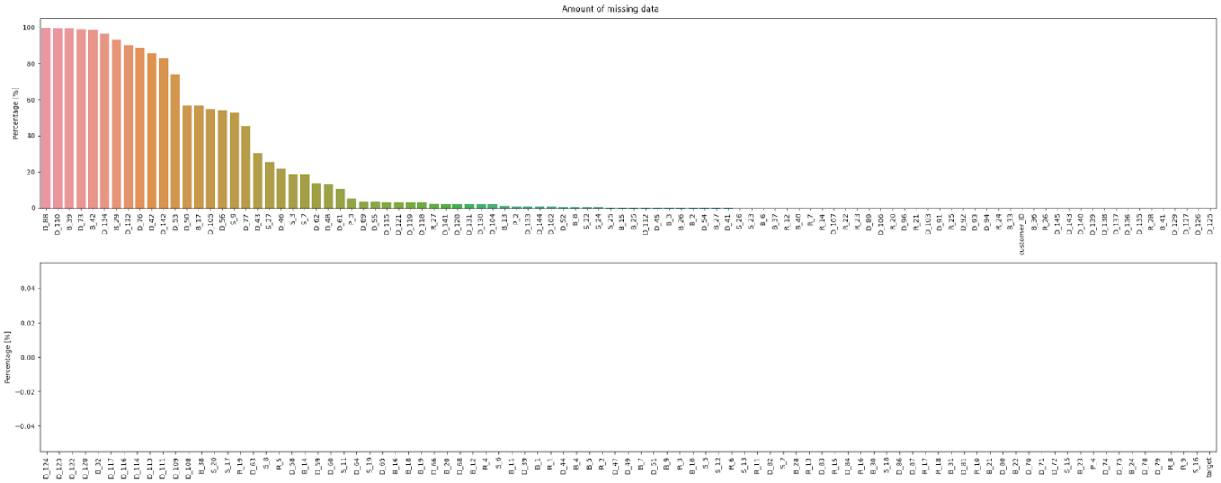
Part 2 >>
Exploratory Data Analysis_Missing Value
Verification_Missing Value
Amount of Missing Data
Percentage(%)
Percentage(%)

Slide 12
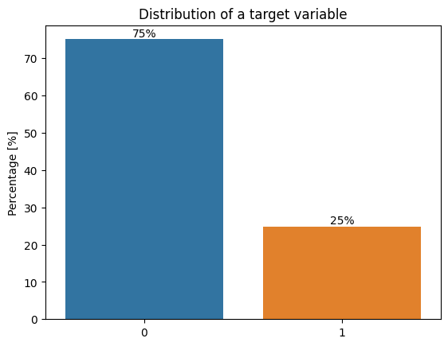
Part 2 >>
Exploratory Data Analysis_Missing Value
Verification_Missing Value
Amount of Missing Data
Percentage(%)
75%
Percentage(%)
25%

Slide 13
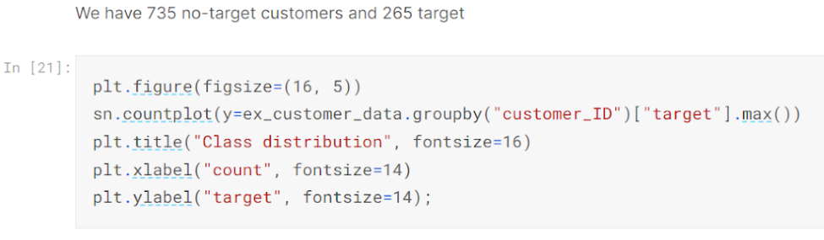
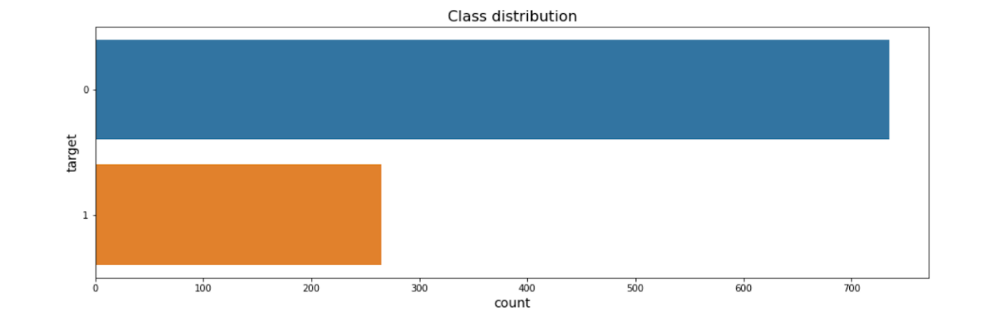
Part 2 >>
Exploratory Data Analysis_Missing Value
“
Verification_Missing Value for 1000 customers
(target=1)
향후 채무 불이행 가능성 : 기본 25%
결측치가 매우 많음. 처리 필요
→ 결측치 비율이 특정 임계값 넘어서면 해당 column제거
735명(75%)
265명(25%)
”

Slide 14
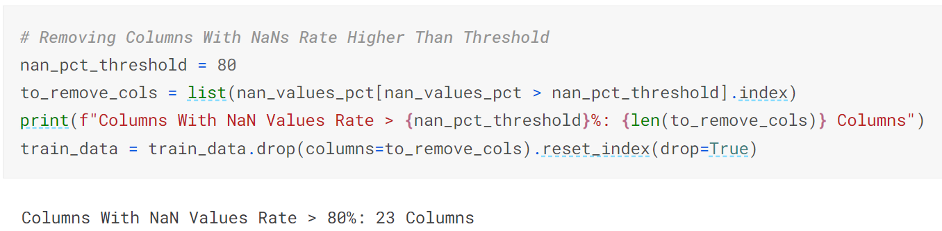
Part 2 >>
Exploratory Data Analysis_Missing Value
“
Verification_Missing Value for 1000 customers
735명(75%)
265명(25%)
”

Slide 15
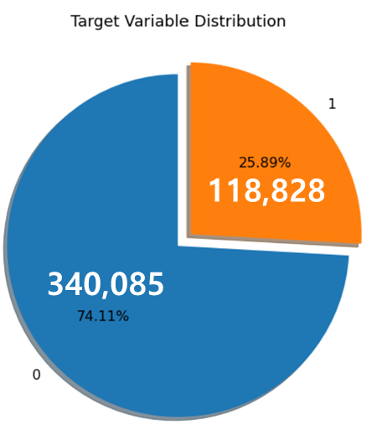
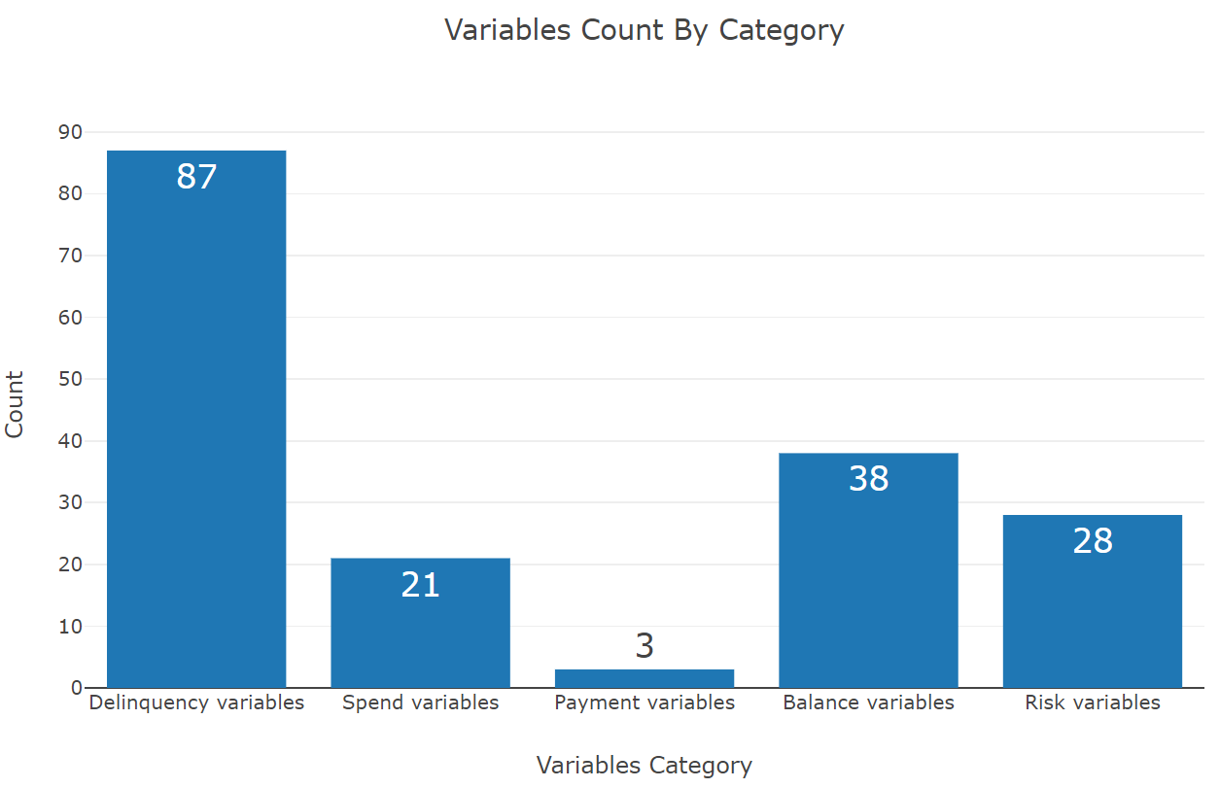
Part 2 >>
Exploratory Data Analysis_Missing Value
Verification_After Missing Value Processing
735명(75%)
265명(25%)

Slide 16
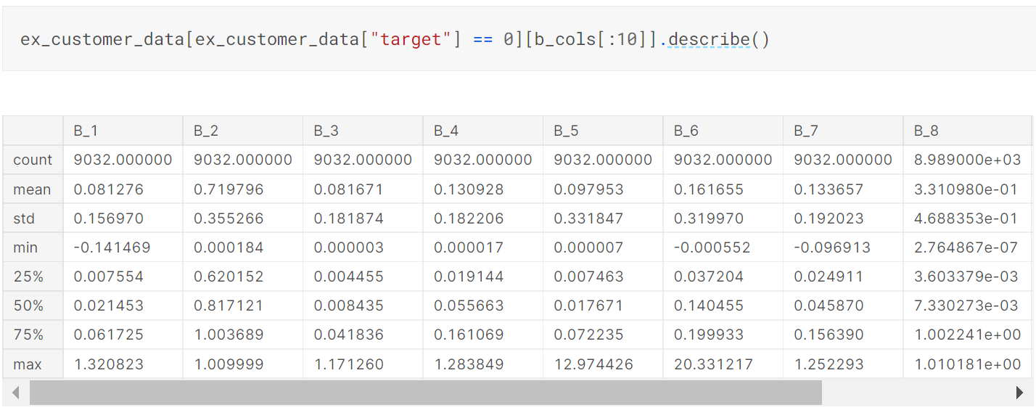
Part 2 >>
Exploratory Data Analysis_ Statistical Values
Verification_Statistical value (count,mean,std,min,max,4분위값)_target ‘ 0 ’

Slide 17
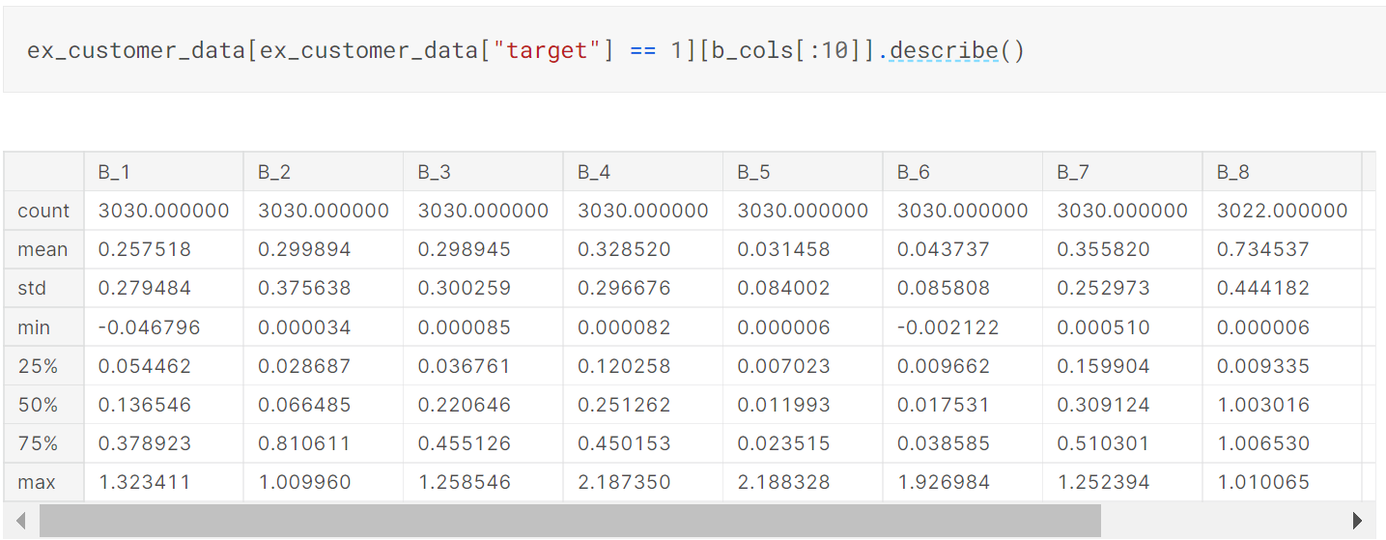
Part 2 >>
Exploratory Data Analysis_ Statistical Values
Verification_Statistical value (count,mean,std,min,max,4분위값)_target ‘ 1 ’

Slide 18
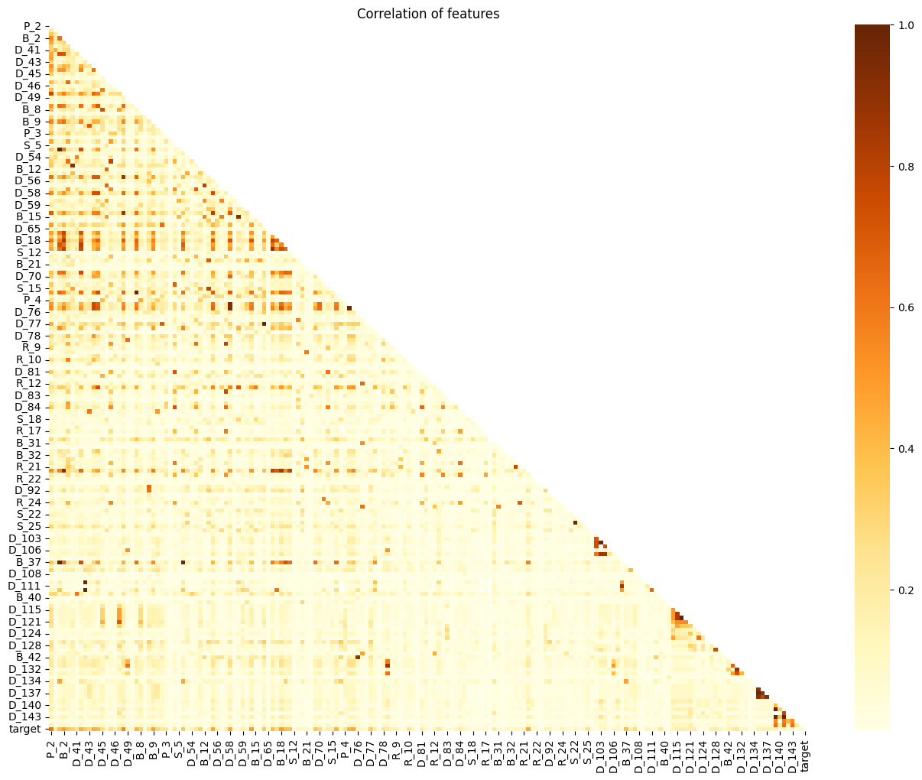
Part 2 >>
Exploratory Data Analysis_Correlation
Verification_Correlation between variables(heatmap)
insight
Feature 상관관계 파악필요
→ Heatmap이용해 시각화
상관관계가 뚜렷하지 않음
일부 색이 진한 점들은 다시 결과값 unstack해야 함

Slide 19
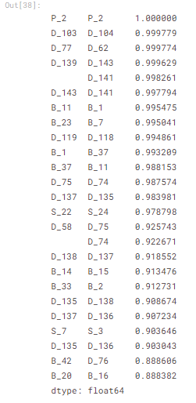
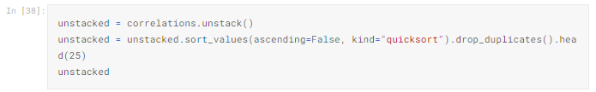
Part 2 >>
Exploratory Data Analysis_ Statistical Values
Verification_Correlation between Unstacked Variables

Slide 20
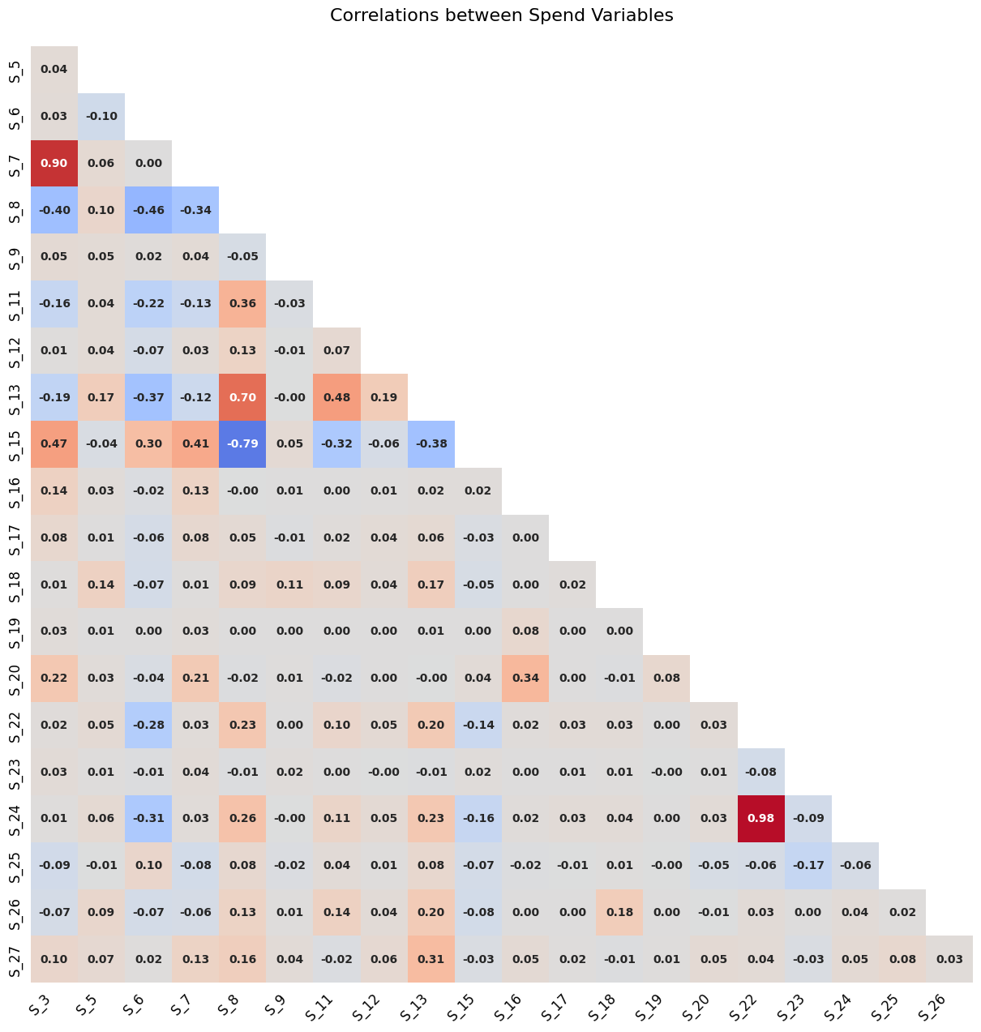
Part 2 >>
Exploratory Data Analysis_ Statistical Values
Correlations between Spend Variables
Verification_Correlation between Unstacked Variables

Slide 21
3
Generate Machine Learning Model

Slide 22
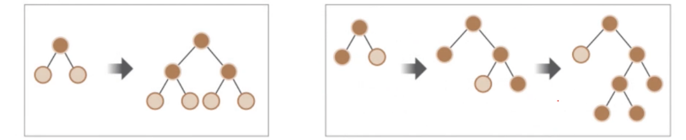
Part 3 >>
Generate Machine Learning Model
1
Random Forest
2
XGBoost
3
LightGBM
4
CatBoost
ensemble⊃bagging⊃RF
Ensemble ⊃ boosting ⊃ GBM ⊃ XGBoost, LightGBM
subsample에 대해 다수의 결정 트리 classifier를 최적화
여러 추론 결과 평균 → 예측 정확도를 개선 → 과적합방지
hyperparameter xgbm보다 적음
트리기반 앙상블 균형트리분할방식
병렬학습이 가능 → GBM의 단점인 오랜 수행시간을 극복
예측 성능 우수
가지치기 기능 존재 조기중단 기능 존재
트리기반 앙상블 리프중심트리분할방식
XGBoost보다 더 빠르고 메모리 사용량 적음
예측 성능 우수
10000건 이하의 dataset처리시 과적합 가능성↑
Categorical Boosting 범주형 feature 처리중점
Gradient Boosting 기반 XGB, LGBM보다 우수
Feature 자동 타깃인코딩
망각 결정 트리 사용 (oblivious decision tree)

Slide 23
Part 3 >>
Generate Machine Learning Model
Study
about
RF
preprocessing
review
code URL[↗]
Learning theory
- parameters
Reduce
Run time
Choose
Baseline
model
tuning
params

Slide 24
Part 3 >>
Generate Machine Learning Model
Study
about
RF
preprocessing
review
code URL[↗]
Learning theory
- parameters
Reduce
Run time
Choose
Baseline
model
tuning
params
RF
Change n_estimators change max_depth change min_sample_leaf

Slide 25
Part 3 >>
Generate Machine Learning Model
Study
about
RF
preprocessing
review
code URL[↗]
Learning theory
- parameters
Reduce
Run time
Choose
Baseline
model
tuning
params
RF
Change n_estimators change max_depth change min_sample_leaf
XGB
add n_estimators change early_stopping change learning_rate

Slide 26
Part 3 >>
Generate Machine Learning Model_Random Forest
No. |  |  |  | scores
1 | Base RandomForest model | 1058.8s - GPU | n_estimators=400, max_features='sqrt', bootstrap=True(default), max_depth=30, min_samples_leaf=1(default), min_samples_split=5, n_jobs=-1 | score: 0.729
2 |  | 477.1s - CPU
3 | change n_estimators (v1) | 290.8s - CPU | n_estimators → 200 | score: 0.727 / ↓
4 |  | 437.6s - CPU | n_estimators → 500 | -
5 | change max_depth (v2) | 547.8s - CPU | max_depth → 100 | score: 0.728 / ↓
6 |  | 538.3s - CPU | max_depth → 40 | score: 0.729 / -
7 |  | 535.3s - CPU | max_depth → 50 | score: 0.729 / -
8 |  | 244.6s - CPU | max_depth → 10 | -
9 |  | - | max_depth → 20 | -
10 | add random_state (v3) | 383.9s - CPU | random_state = 77 | -
11 | change min_samples_leaf (v4) | - | min_samples_leaf → | -
내용요약
소요시간
parameters

Slide 27
Part 3 >>
Generate Machine Learning Model_XGBoost
No. |  |  |  | scores
1 | basic XGB model | 190.8s(GPU) | (n_estimators : default 100, early_stopping_rounds=100, learning_rate=0.05) | 변동없음
2 | add n_estimators | 186.6s(GPU) | n_estimators=110
3 |  | 176.8s(GPU) | n_estimators=120
4 |  | 190.4s(GPU) | n_estimators=130
5 |  | 191.8s(GPU) | n_estimators=140
6 |  | 196.2s(GPU) | n_estimators=150
7 |  | 183.4s - GPU | n_estimators=200
8 | change early_stopping option | 192.0s - GPU | n_estimators=200, early_stopping_rounds=150
9 | change n_estimators | 201.1s - GPU | n_estimators=300, early_stopping_rounds=150
10 | change learning_rate option | 179.0s - GPU | n_estimators=200, learning_rate=0.1, early_stopping_rounds=100
11 |  | 246.3s - GPU | n_estimators=200, learning_rate=0.2, early_stopping_rounds=100
내용요약
소요시간
parameters

Slide 28
4
Insight about ML models & TODO

Slide 29
Part 4 >>
Insight about ML models & TODO
XGBoost
Random Forest
ensemble
LightGBM
Catboost

Slide 30

Q&A

